Slide 1

IoT-based Platform
Air Quality (PM2.5) Monitoring System
Project Members:
Suyogya Ratna Tamrakar (st121334)
Younten Tshering (st121775)
Smrity Baral (st121662)
Shubhangini Gontia (st121473)

Slide 2
Outlines
Introduction
Overview
Functional requirements
Nonfunctional requirements
System models – Use case Diagram
Dynamic models – Sequence, State and Activity Diagram
Object and class model – Class Diagram
User interface – Screen Mockup
Conclusion

Slide 3
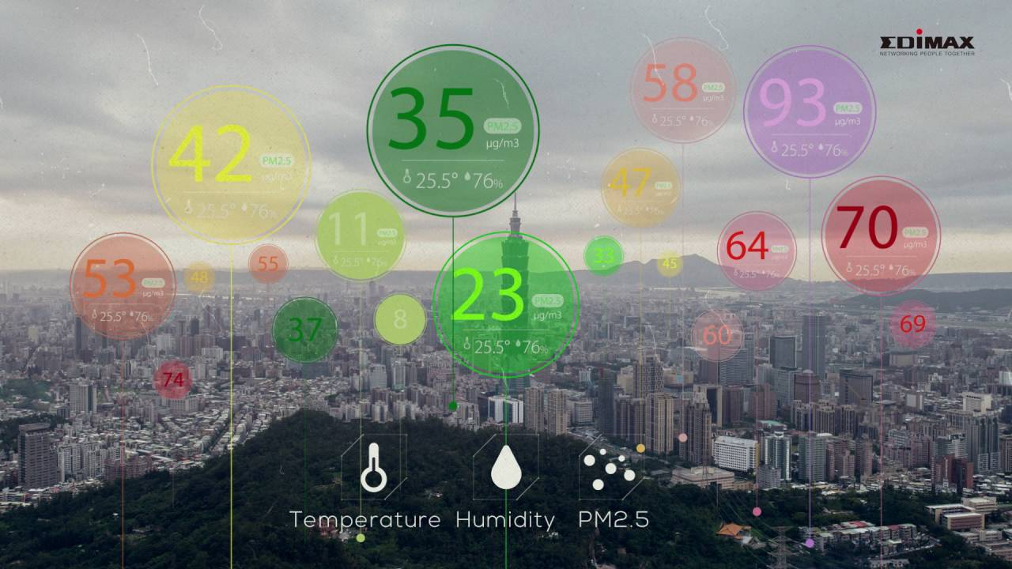
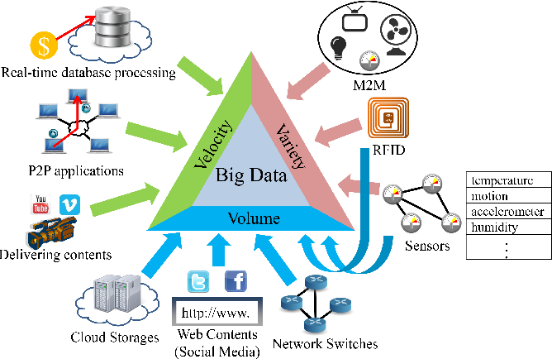
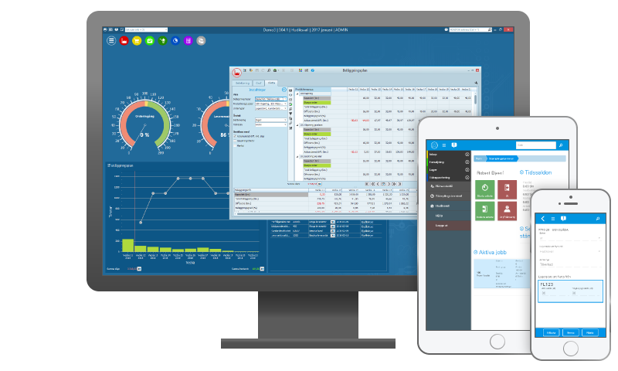
Introduction

Slide 4
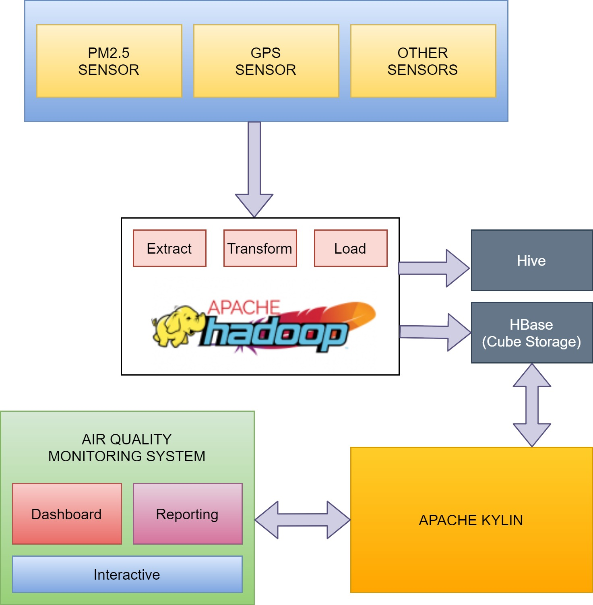
Overview

Slide 5
Functional requirements
Visualization Module
The end users should be able to view an interactive dashboard of air quality monitoring with different forecasts and insights.
The system should be able to stream real-time data from different nodes and stations.
System Admin Module
The admin should be able to login, logout to the system and modify the system parameters and toggle dashboard controls.
The admin should be able to register new sensors and manage the sensors in system.
The admin should be able to generate reports of specific time periods and export those in varies formats.
Data Collection Module
Data will be extracted from sensors and stored in Hadoop which is acting as data warehouse using Hive.
Kylin does aggregation functions on cube (HBase) and provide the required parameters to the system.
Notes:
Note:
Air quality and location details provided to the system from the sensor shall be stored in the database (Hadoop).
The information shall be accessible via distributed system and JPA (Java Persistence API).
The data stored should be able to be manipulated through interface.

Slide 6
Nonfunctional requirements
Performance
Reliability
Interoperability
Portability
Scalability
Reusability

Slide 7
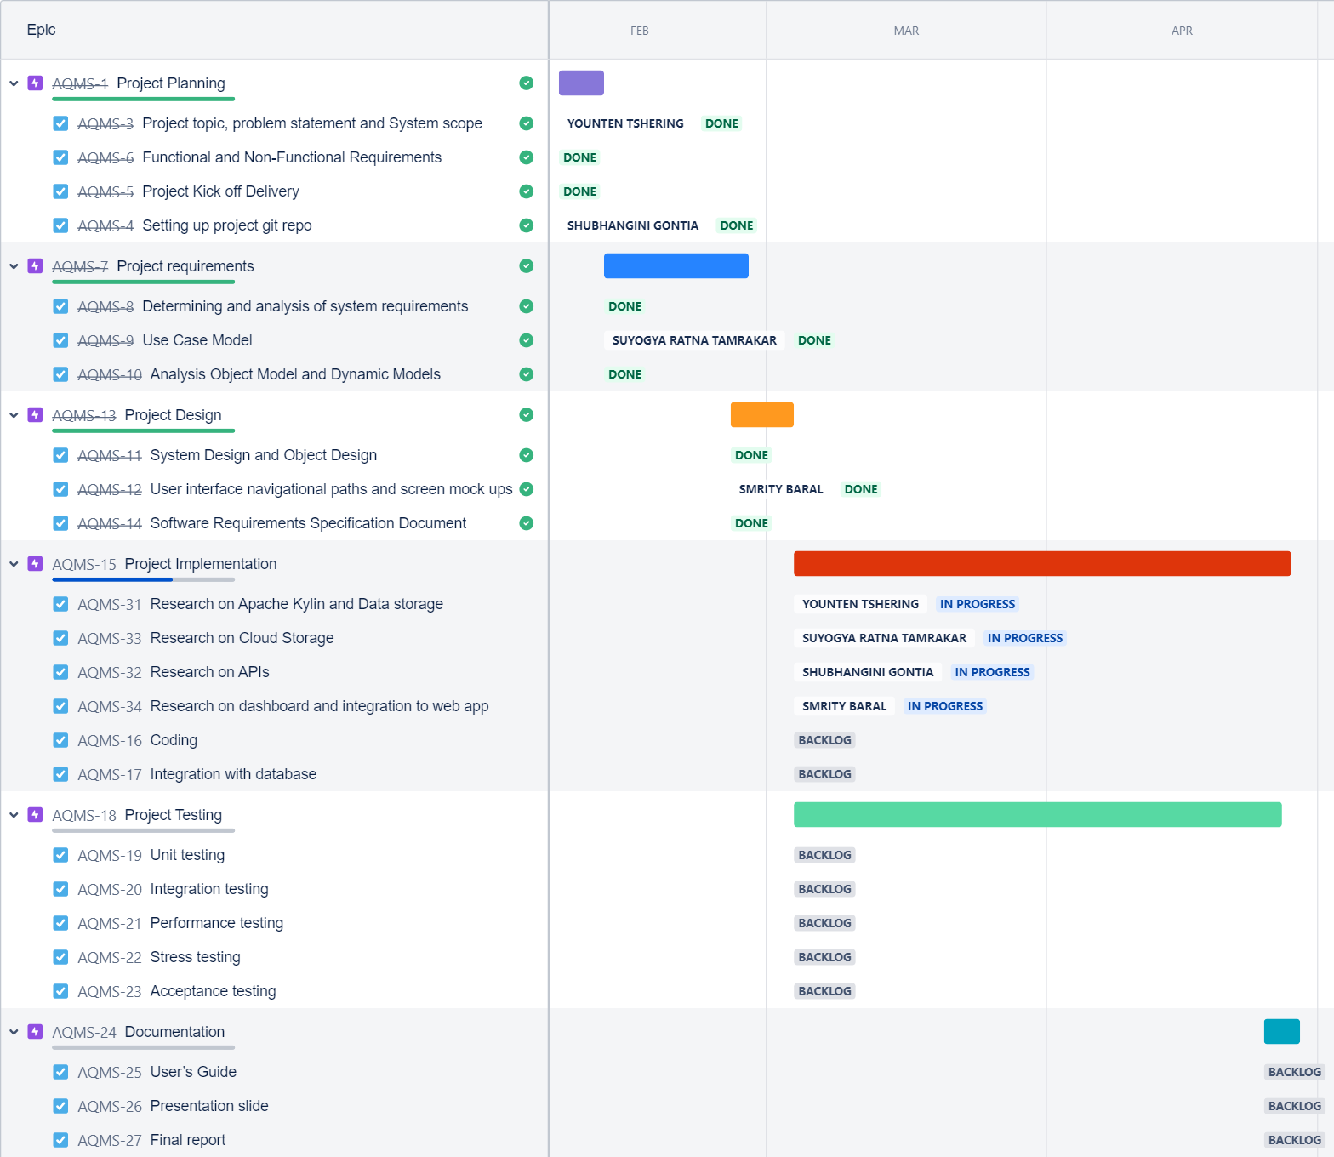
Schedule

Slide 8
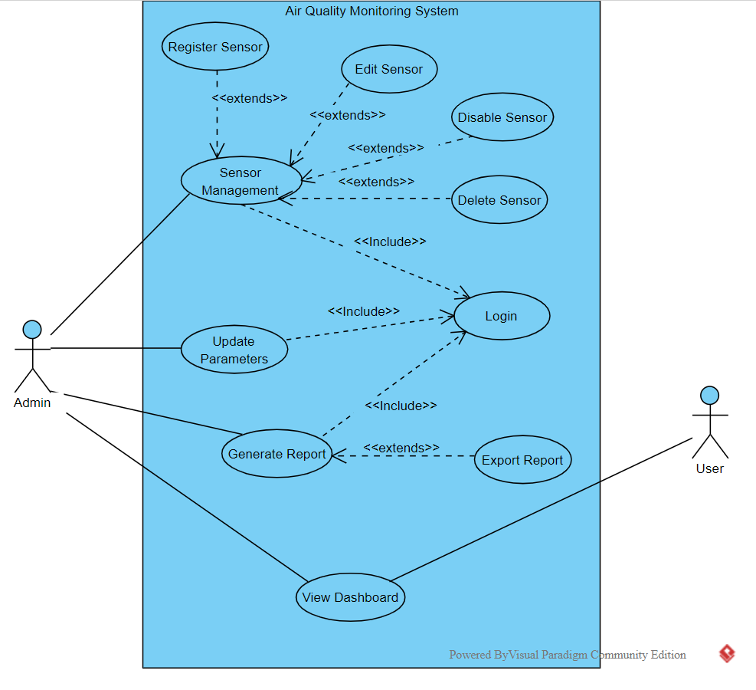
System models

Slide 9
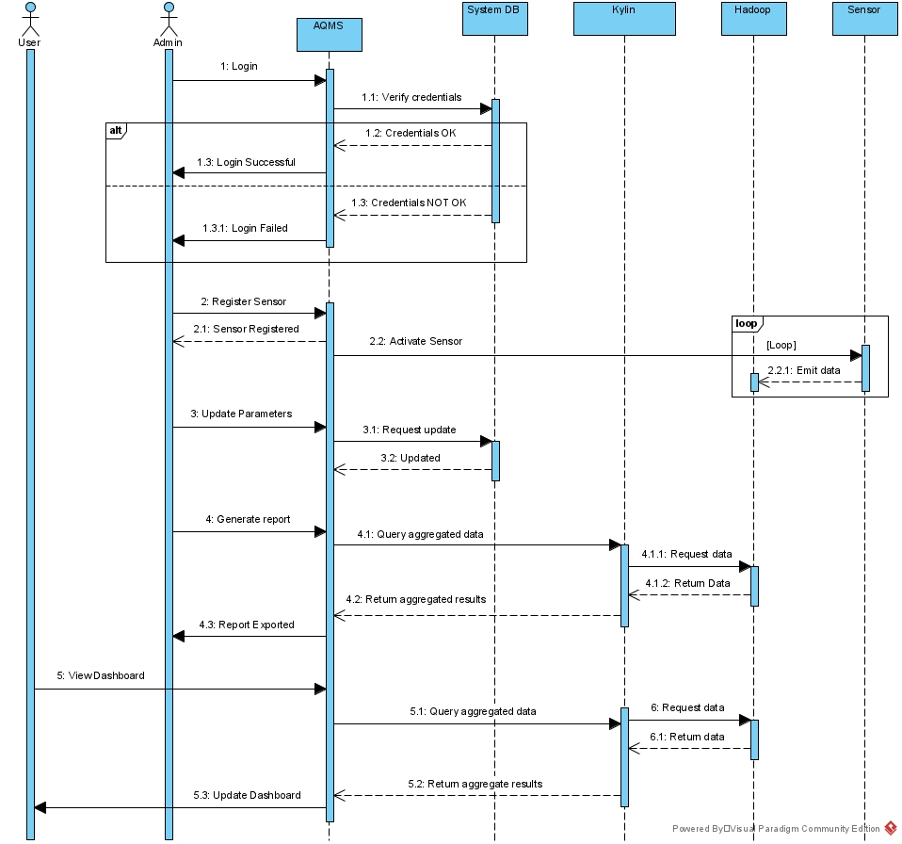
Dynamic models

Slide 10
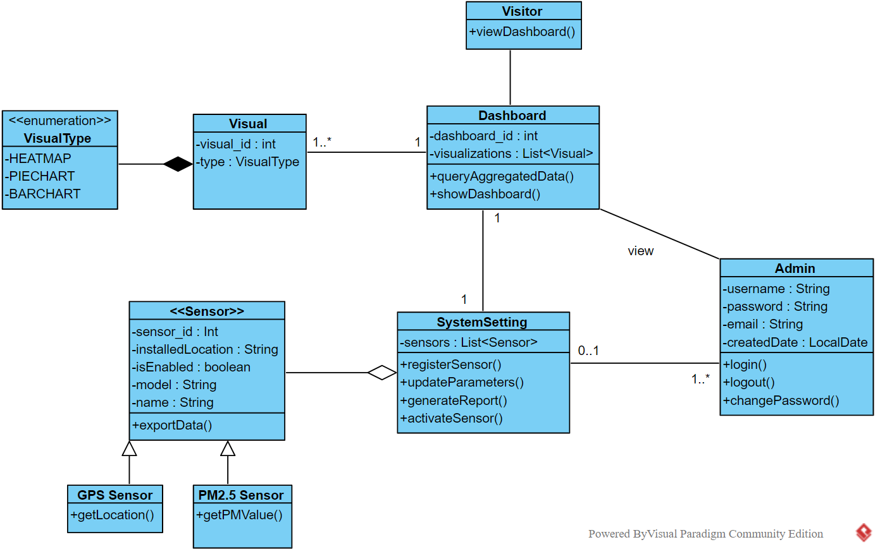
Object and class model

Slide 11
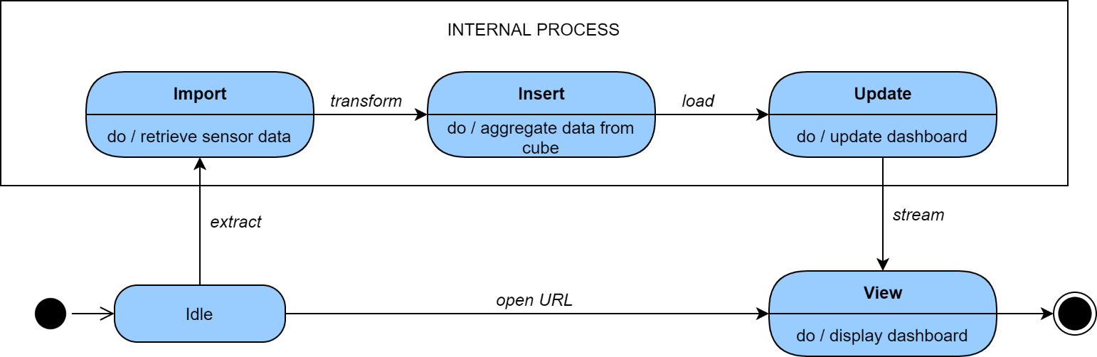
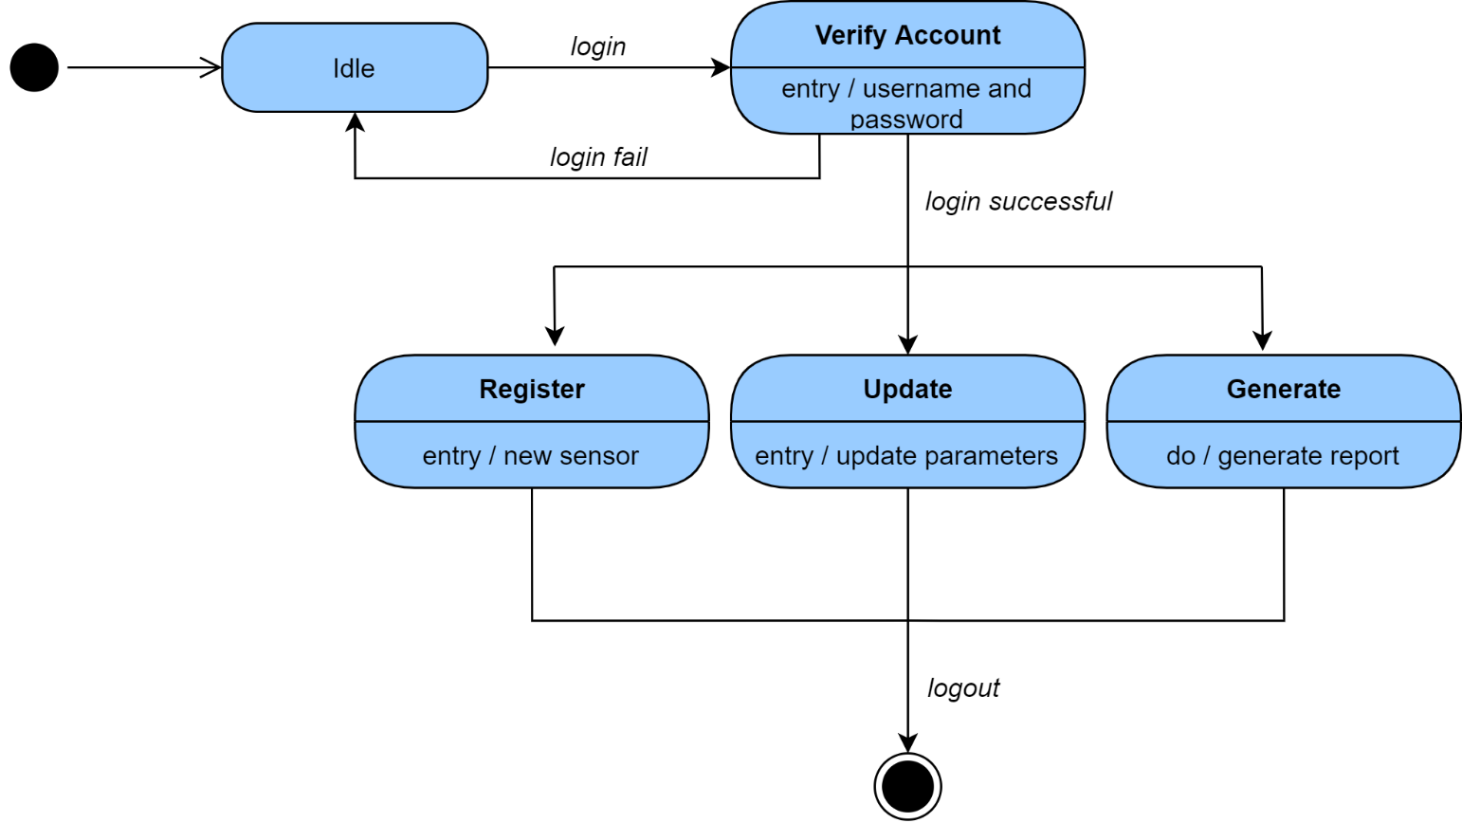
Dynamic models

Slide 12
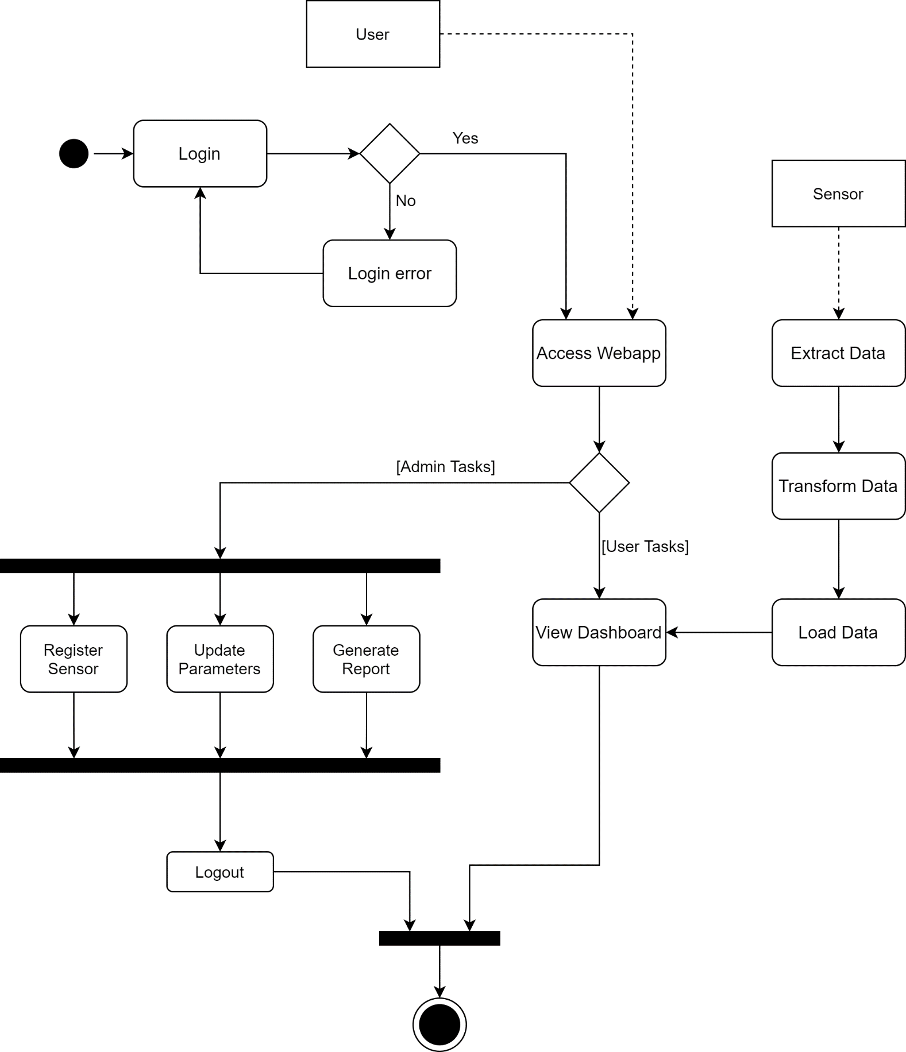
Dynamic models

Slide 13
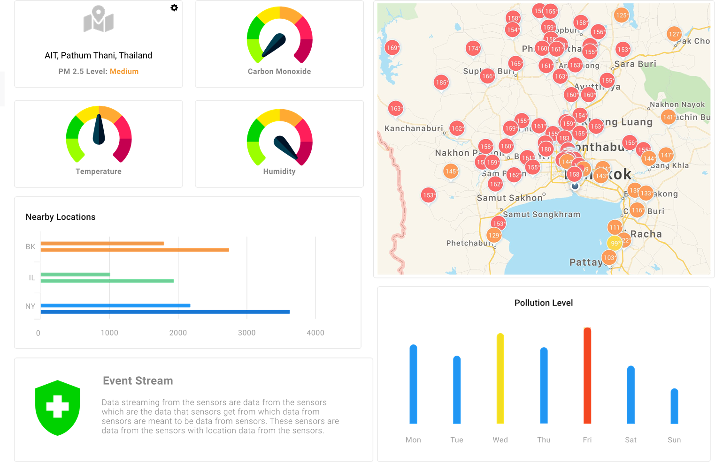
UI Mockups

Slide 14
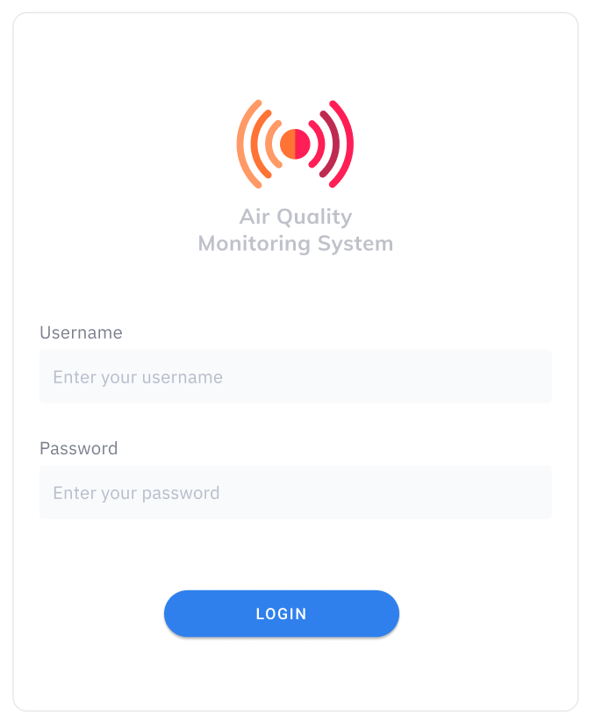
Admin Login Form

Slide 15
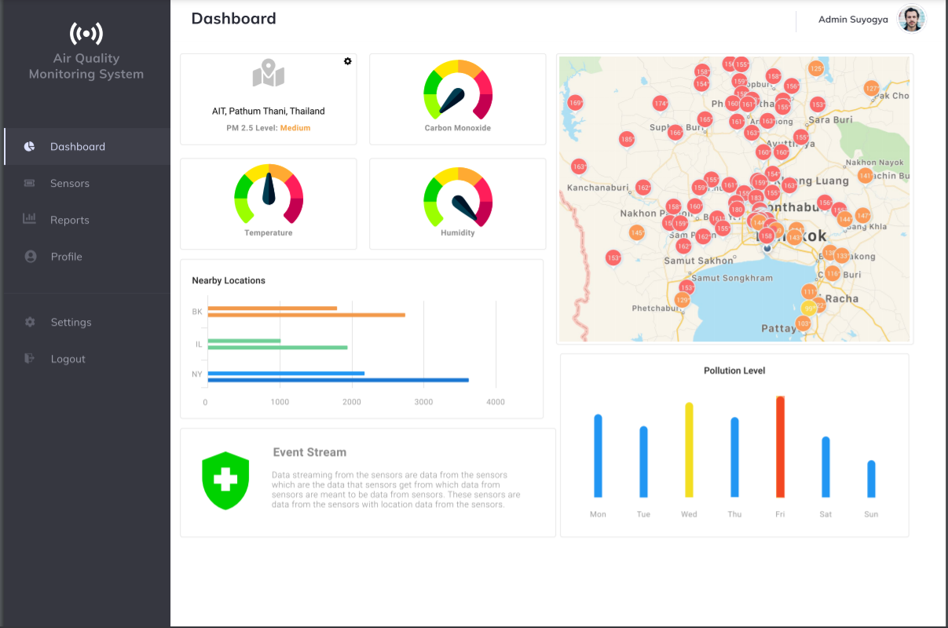
Admin Dashboard

Slide 16
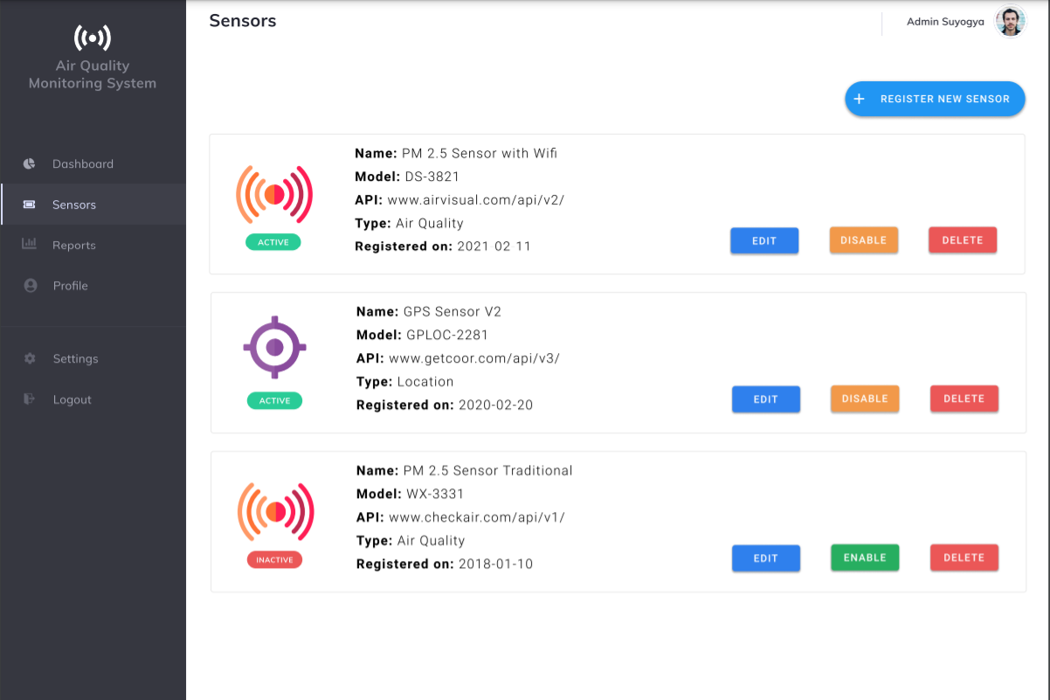
Sensors Management

Slide 17
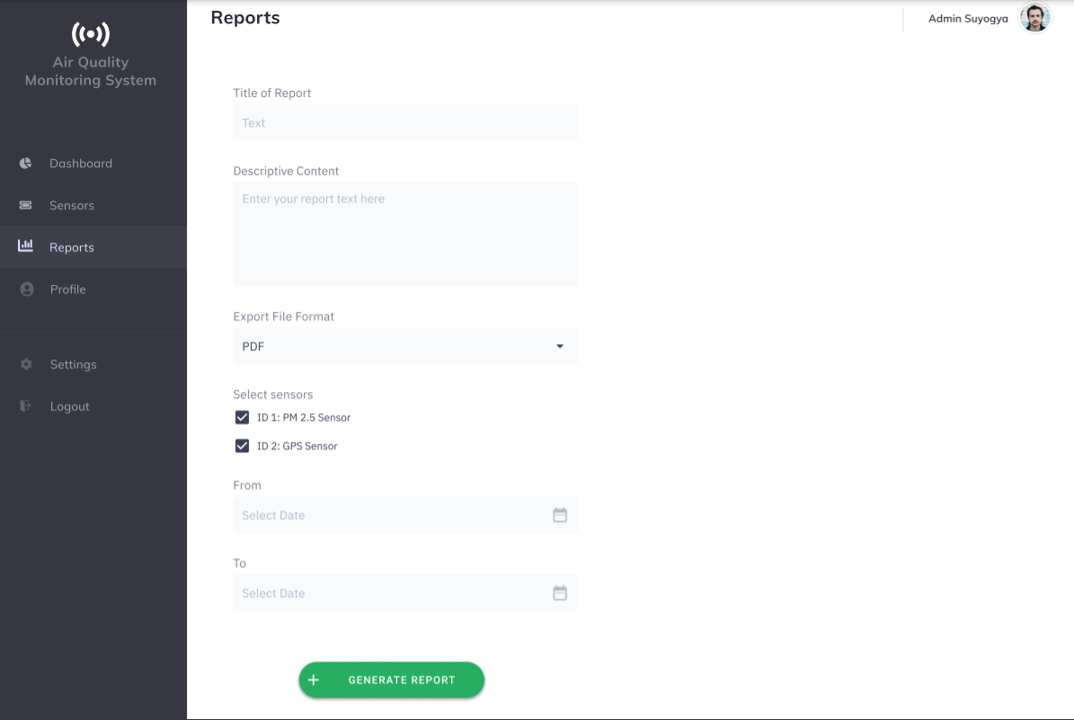
Reports

Slide 18

Update Profile

Slide 19
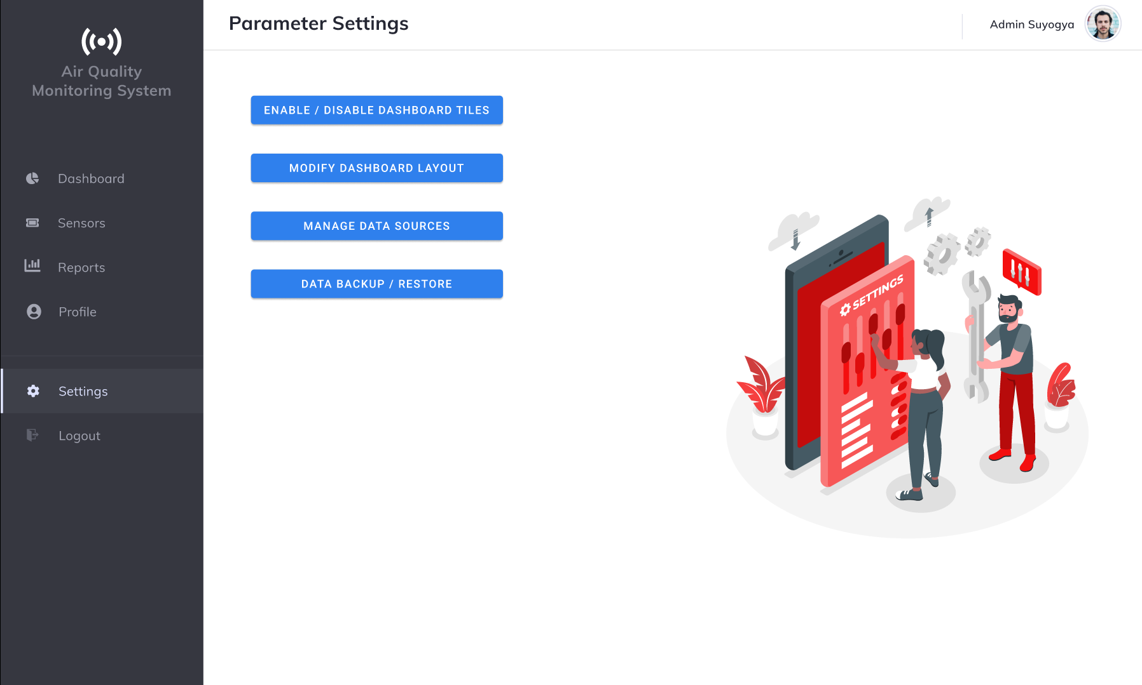
Parameter Settings

Slide 20



Conclusion
The system ‘Air Quality (PM2.5) Monitoring System’ will be especially designed to be used by any user who are cautious about their health.
https://github.com/shubhanginigon/SDQI2021_G1

Slide 21
References
Apache Kylin. ( 2015). Bring OLAP back to big data! Retrieved from Apache Kylin | Analytical Data Warehouse for Big Data
Fann,N.,& Risley,D. (2011,January 5). The public health context for PM2.5 and ozone air quality trends. Air Qual Atmos Health 6, 1–11 (2013). https://doi.org/10.1007/s11869-010-0125-0
Gupta,A.k., & Johari,R. (2019). IOT based electrical device surveillance and control system. International Conference on Internet of Things: Smart Innovation and Usages (IoT-SIU), https://doi.org/10.1109/IoT-SIU.2019.8777342
https://github.com/shubhanginigon/SDQI2021_G1

Slide 22
Questions and
Feedback

